Slide 1
Richard Miller Associates, LLC
Consulting and Managing Marketing Research

Slide 2
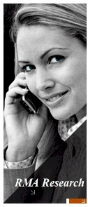
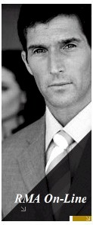
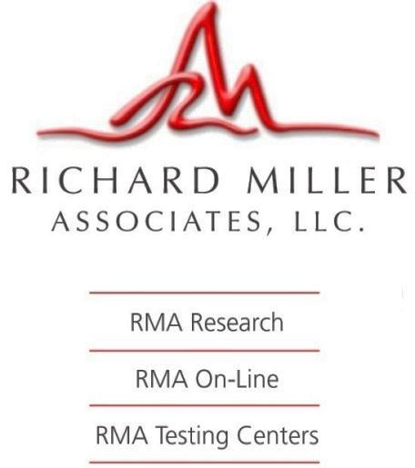
Richard Miller Associates, LLC
Introducing the TEAMS in Richard Miller Associates
Since 1977, the Associates of Richard Miller have brought together marketing research companies from FOUR distinct services offering our clients a complete set of teams for research within the North America. As a result, Richard Miller Associates has been created for overseas clients who need assistance in completing their marketing research studies coupled with consulting about how consumers think in the USA and North America. Whether your needs are consulting or managing data collection or online panels, Richard Miller Associates has what you need to make every business decision the right one.
Richard Miller Associates, LLC. © 2016

Slide 3
Richard Miller Associates, LLC
The Global Perspective
Since starting in the business of marketing research in the USA over 30 years ago by assisting those with marketing research needs and then traveling extensively throughout the world, our company has established itself in the global arena by providing the North American perspective.
As we work with clients in the USA, Europe, Korea, Japan, or Asia in providing Marketing Research Services and Data Collection, we give input to the added dimensional challenge of cultural differences, language barriers, and foreign products and services.
It’s our passion and it is what we love to do with . . .
Working with and representing the needs for marketing research in North America.

Slide 4
Richard Miller Associates, LLC
Our Teams
Richard Miller Associates can put together a team for
Our a la carte or one-stop research services team for marketing decisions.
Our Automotive Division team for on-going measures of product quality, customer satisfaction, buying behavior and new product direction / development. OR the “Great Research Studio” in New Jersey offering the COMPLETE Marketing Research Studio for your Automobile Clinics or Large Display studies.
Data Collection Team with our own Remote CATI system or Affiliated Testing Centers within the USA with 55 nationwide USA / Canadian markets in 25 primary areas where we complete our pre-recruited studies.
RMA On-Line “Research Reward®” -- our blended web-based panel interviewing throughout USA/Canada.
. . . our Teams service, consult and field manage marketing research – with over 30 years of proven expertise, reliability and integrity.
Richard Miller Associates, LLC. © 2016

Slide 5
Richard Miller Associates, LLC
RMA Study Expertise
Market Definition Market Segmentation/Market Structure Studies Brand Equity/Positioning Studies Attitude & Usage Studies (A&U’s) ATUs Loyalty Communications Research Brand and Advertising Tracking Corporate Image Studies Advertising Claims Research Copy Testing Brochure Testing Name Testing Logo Testing Website Design/Evaluation Customer Satisfaction Research Service Expectation Assessment Customer Satisfaction Tracking Attrition Studies Customer Service Monitoring | Product Development Research Feature Appeal Pricing Optimization Concept Tests Product Optimizations Advance Design and Features Employee Research Legal Research / Mock Juries Data Collection Internet Based Web Based Questionnaires International Research Telephone CATI Research Executive/Professional Interviewing Mail Research Personal Interviews/Mall Research Mystery Shopping
Richard Miller Associates, LLC. © 2016

Slide 6
Richard Miller Associates, LLC
RMA Industries and Services Researched
Advance Design ** Advertising ** Aerospace Agriculture Automotive ** Biotechnology Chemicals Communication Computers ** Construction Consumer Goods ** Disposables Durables ** Electronics ** Energy Entertainment ** Environmental Finance Food / Beverages ** Fragrances ** | Greeting Cards ** Health Care ** Heavy Industry Housing ** Manufacturing Media / Publishing Merchandising Packaging ** Pharmaceuticals Product Planning ** Real Estate Services Software Technology ** Telecommunications ** Textiles Tools ** Tourism US Government ** Indicates Specialty
Richard Miller Associates, LLC. © 2016

Slide 7
Richard Miller Associates, LLC
We have completed over 1000 studies annually for a variety of clients with RMA’s various Teams. Virtually ALL our studies are of ‘product’ orientation or of a pre-recruited nature or Customer Satisfaction. We are not specialists for image, advertising, political or government research.
RMA in the past 10 years has successfully completed over 150 gang pre-recruited interviews and automobile clinics with over a 94% overall respondent show rate. Our clients comment on:
The articulation, knowledge and subject experience of our respondents
The accurate quota distribution as originally specified
The accuracy and thorough editing of all data and reports
The availability of immediate preliminary reports due to advanced technology
The commitment to adhere to all original timelines – being available at the times
you need us to be
Our exceptional on site experience, nothing short of a 5-star rating
The final recommendation and reporting summaries FREE after the FGDs and IDIs
97% overall client satisfaction rate based on solicited and unsolicited ratings
Moreover, you will have a designated Team from Richard Miller’s staff for personal attention and expertise in completing your project and all other work with you.
RMA Project Experience
Richard Miller Associates, LLC. © 2016

Slide 8
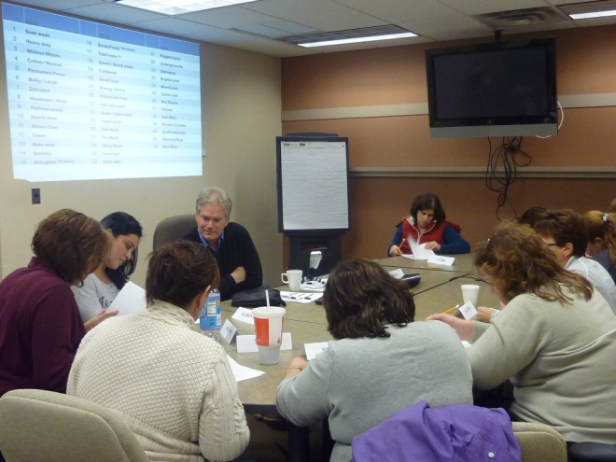
Richard Miller Associates, LLC
RMA Consulting and Management
Quantitative Research
Our teams assure your research designs work in North America, with question word-smithing, Americanization and editing to assure English understanding and comprehension
Consultation availability for special analytical techniques (CBC Conjoint, correlation/regression, perceptual mapping, factor analysis, cluster analysis, discriminate analysis)
Qualitative Research
Group facilities, moderating, transcriptions and summaries
1-on-1 executive interviewing and analysis
Facilitation and Managing Marketing Research
Ideation sessions for new products/strategies/ideas
Field Management
Programming for CAPI / CATI / Web with coding and exporting to your data map and format
Availability of Reporting and Presentations
In short, our Teams use gang interviews, focus groups, product clinics, in-depth interviews, phone interviews, mail surveys, online research, in-home interviews, shadow shopping and face-to-face interviews to get answers to questions. Then the team will provide ONLY the services that you request for your research.

Slide 9
Richard Miller Associates, LLC
RMA Team Management
Richard Miller Associates designates a Team to coordinate your research with our various RMA divisions or our affiliates. We have the SOLUTIONS and RESOURCES for providing responses to your questions for feasibility, cost, timing, staff (including moderators) and the knowledge for data collection and sampling for the USA and Canada
Teams: We work to select the best team to work on your project
Solutions: The answers you need for the decisions that work.
Data Collection: The resources to get your data collected in North America !
Resources: The real key to successful research is having resources to get the data that is actionable.
Richard Miller Associates, LLC. © 2016

Slide 10
Richard Miller Associates, LLC
RMA Team Implementation
Our Team will assist our clients to better understand the wants and needs of current and potential North American customers so their companies and clients can make smarter decisions – better, faster and less expensively .
If you have “Research-based Marketing” or “Marketing-based Research” (or if you have a well-defined process and are seeking a new partner in the USA), RMA understands working with overseas clients.
Success of your project begins with your RMA team for expert problem finding and planning. And with our expansive RMA owned network, we assist you with your problems, we are responsive, timely & cost efficient.

Slide 11
Richard Miller Associates, LLC
RMA Testing Centers
Not all products are suited for research conducted by phone, mail or the Internet. Testing Centers allow Face to Face, IDI or Gang interviews to be conducted qualitatively or quantitatively with . . .
Test products that need to be seen, picked up or touched.
A controlled environment.
Complicated rotations and multiple products.
Placements of products for in-home use tests.
Products that are frozen or refrigerated, fragile or large, or require a demonstration.
Viewing respondent reactions behind a one-way mirror.
Pretesting of the questionnaires and research methodology.
We measure consumer reactions by their senses for
Touch, Taste, Feel, Smell, Sound and Sight!!

Slide 12
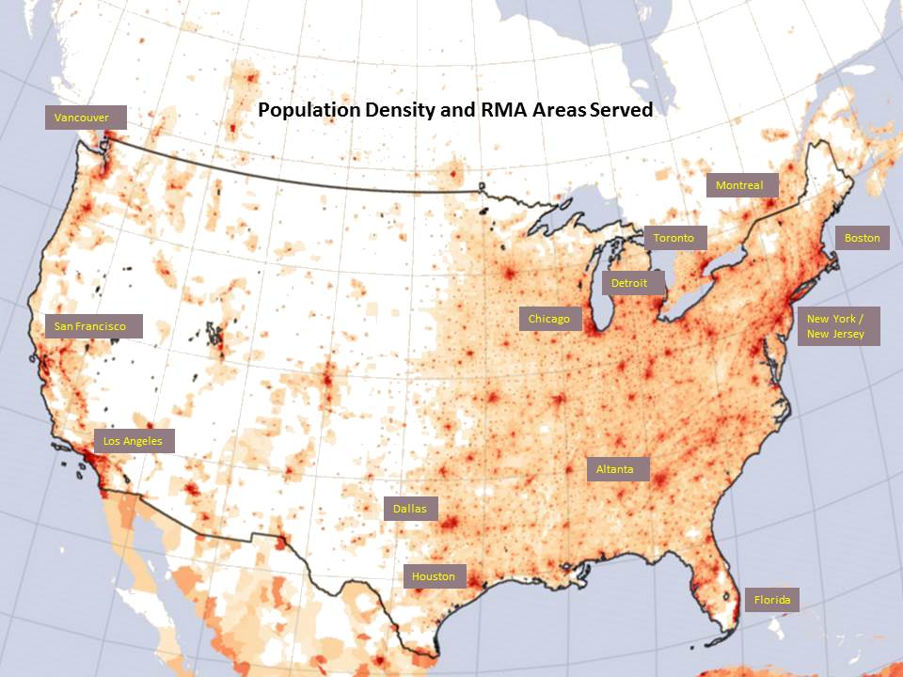
Richard Miller Associates, LLC
RMA Testing Centers
Face to face interviewing uses a variety of recruiting techniques to find your targeted group of respondents cost effectively – including the use of pre-recruiting, intercepting, databases and convenience sampling.
Testing Center associates have over 55 permanent offices in more than 25 areas with significant Population Density including . . .
East Coast New York City / New Jersey Canada
Boston Toronto
South Houston Montreal
Atlanta Vancouver
Florida
Midwest Chicago
Detroit
Dallas
Houston
West Los Angeles / Orange County
San Francisco
San Diego
For those who prefer downtown locations, we now have exclusive arrangements with selected Focus Group facilities in New York, Chicago, Los Angeles, Atlanta and San Francisco.
We also Manage the marketing research and facilities with other proven and qualified firms in non-associated cities across the USA and Canada and with select countries throughout the World.

Slide 13
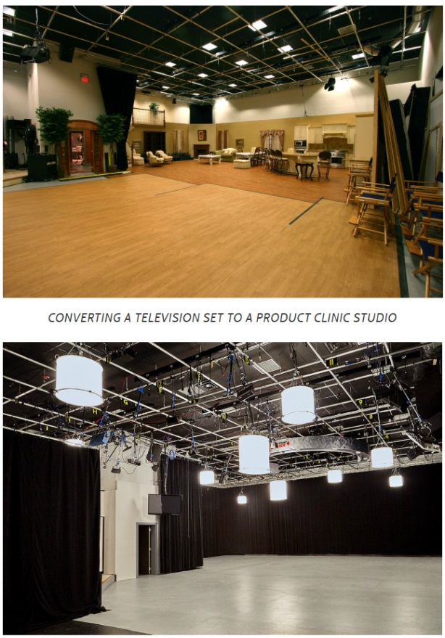
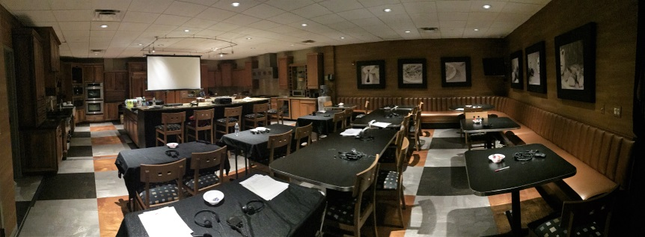
Richard Miller Associates, LLC
RMA Centers for
Automobile Product Clinics
The Great Research Studio is the newest addition to RMA’s Group of Companies. The Great Research Studio facility is NOT a warehouse, but is a fully equipped movie studio facility that has virtually everything you will need right on location to setup and conduct your sophisticated research clinics and studies.
The rental of the facility will be exclusive to you with highest levels of security and can be adapted for:
1 to 7 car product clinics
Sophisticated Multi-media presentations
Focus Groups, IDIs, Mini-FGDs, Gang Sessions and sales meetings / presentations
Movie screenings, drive and ride, and special events
Order what you need, provide you own, or use our complete research staff to assist you and your staff for a successful and delightful clinic experience !

Slide 14
Richard Miller Associates, LLC
RMA On-Line with “Research Reward” Panel
Offering blended web-based panel interviewing
Face to Face or Internet Panels?? With Richard Miller Associates, the choice is yours.
Today, Internet Based Interviewing has become the standard for interviewing with virtually ALL of our quantitative research being completed using our Web Based Questionnaires .
Why use our “Research Reward®“ Blended Panel?
In short,
We provide a SOLUTION for the completion of virtually ALL types of samples.
We use our RESOURCES to get those hard to find respondents whether from our database, our blended internet samples or our Testing Centers.
We UNDERSTAND the North American market to assure you get the data and the results your client expects.
We are EXPANDING our blended panel to include samples INTERNATIONALLY so we can assist in multi-country / multi-language projects using ONE SOURCE for your data collection.
Richard Miller Associates, LLC. © 2016

Slide 15
Richard Miller Associates, LLC
RMA On-Line with “Research Reward” Panel
Offering blended web-based panel interviewing
Unlike others that only have a single panel, RMA On-Line has its “Research Reward ®“ managed “blended” panel to fulfill sample requests of any kind in the USA and Canada.
Richard Miller Associates, LLC. © 2016

Slide 16
Richard Miller Associates, LLC
RMA On-Line with “Research Reward” Panel
Offering blended web-based panel interviewing
Internet Interviewing is not a matter of simply emailing invitations to respondents to be interviewed !!
With the proven quality of recruiting and excellent service, RMA On-Line now delivers Internet Interviewing in affiliated Testing Centers, in respondents’ homes or on the telephone.
In summary, RMA On-Line . . .
provides sampling and managed panel options, with consumers and businesses of all kinds
fulfills the sample quotas – we never miss our targeted samples
executes sophisticated on-line questionnaires and CBC conjoint
provide the data / results in virtually any format you request
works with you and the data in providing the insight into making smarter decisions
Richard Miller Associates, LLC. © 2016

Slide 17
Richard Miller Associates, LLC
RMA Telephone Centers
As part of our work, our telephone centers are one of the most important in integral parts for the success of our projects. In ALL aspects of our work, the telephone centers play a MAJOR part.
BUT RMA’s telephone centers use traditional central locations PLUS supplemental remote telephone centers:
Our staff and interviewers are now all over the USA.
Our databases, call lists, staff, computer equipment and software are the integral components for our success.
RMA has developed our own software to meet the needs of our staff and the needs to complete the research. We do not take someone else’s software and adapt it to the needs of our staff in getting the research completed.
And we maintain the HIGHEST standards to assure the work is being completed with the highest quality and meets the needs of our clients.
Richard Miller Associates, LLC. © 2016

Slide 18
Richard Miller Associates, LLC
RMA Telephone Centers
We are very proud of the addition of our Remote Web CATI system to supplement our CATI facility.
Our system provides our staff and our clients:
Flexibility
Control
Maximum coverage for all hours of the day and weekends
And we and our staff LOVE the ability to work when, where and how often they can work and have the independence we need in working !
Most importantly, we can handle almost all projects !!
Richard Miller Associates, LLC. © 2016

Slide 19
Richard Miller Associates, LLC
With Richard Miller Associates,
you can have you own Team !!
Better
Marketers (more than just “researchers”) designing and analyzing customized research.
Data collectors with a marketing perspective and fields of expertise with long term relationships and integrity.
Large databases and web panels for consumers and businesses.
Faster
Next-day analysis of qualitative and quantitative studies.
Internally developed procedures and control assure faster completion of your study from design to reporting.
Will work 24/7 on your project – our responsiveness is unparalleled among your choices in the USA and Canada.
Less Expensive
We have low overhead and with our affiliated companies for ALL types of research (including our ‘Great Research Studio’) – the result is pricing within your budget.
No job is too large or too small – we always meet your quotas.
Providing value for your dollar by understanding your research needs and using proven methods to complete the data collection.
Richard Miller Associates, LLC. © 2016

Slide 20
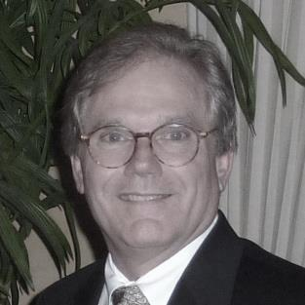
Richard Miller Associates, LLC
The RMA Founder
Richard Miller President and CEO of RMA
Richard is the founding member of Richard Miller Associates and Consumer Pulse, Inc. (CPI), CPResearch Group, Inc.
The company background stems from Automotive and Durables Advance Product Planning and Advertising. Today, RMA is multifaceted with services, facilities, nationwide staff and personnel / moderators, panels and databases and is interlaced with his other companies who assist in providing the services needed for successful completion of research projects in the USA and Canada.
Our companies have been pioneers in multi-city “Team” activities and in adopting and developing computer-assisted interviewing techniques, personal computer-based data tabulations, and techniques in qualitative and quantitative research. Richard serves as RMA's leadership – directing RMA’s Teams for hundreds of studies using a variety of methodologies and techniques, including face to face, CATI, mail, web (several of which studies had tens of thousands of sample size as well as new product development / advertising research using quantitative and qualitative research.)
Richard Miller, upon request, will work with a Team to assist in the overseeing of the design, moderation, interviewing and data processing activities as well as project direction, field management, data processing and analysis functions of qualitative and quantitative research -- and for those who seek his personal consultation.
Richard Miller Associates, LLC. © 2016

Slide 21
Richard Miller Associates, LLC
"What else would you like to know?"©
Contact us
and we will help you
find exactly what you need!!
Your FIRST step . . . Telephone: +1 248 672-1644 Email: RMiller@RichardMillerAssociates.com Feel free to write or call anytime!
Richard Miller Associates, LLC. © 2016

Slide 22
Richard Miller Associates, LLC
Thank you and
we look forward to working with your Teams !!

